Slide 1
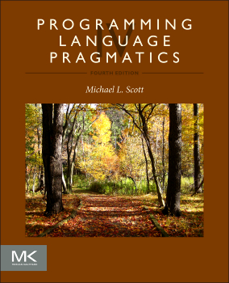

Chapter 1 :: Introduction
Programming Language Pragmatics, Fourth Edition
Michael L. Scott
Copyright © 2016 Elsevier

Slide 2
Introduction
Selected excerpt from Chapter 1 of Scott’s textbook slides
Modified by H. Conrad Cunningham, Professor, Computer and Information Science, University of Mississippi
Included ideas from Mitchell’s textbook and other sources

Slide 3
Compilation vs. Interpretation
Compilation vs. interpretation
  not opposites
  no absolute distinction

Slide 4
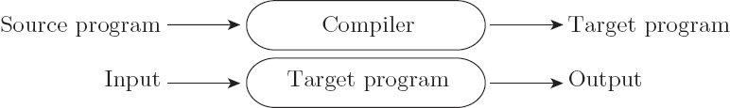
Compilation vs. Interpretation
Pure compilation
  compiler translates source program into equivalent target program, then goes away
  often high-level language (source code) translated to machine language (object code)
  OS later executes target program on machine
  target program is locus of control

Slide 5

Compilation vs. Interpretation
Pure interpretation
  interpreter stays around for execution of program
  interpreter is locus of control during execution
  interpreter implements virtual machine

Slide 6
Compilation vs. Interpretation
Interpretation
  greater flexibility
  better error messages (e.g., good source-level debugger)
  dynamically create code and then execute it
Compilation
  better performance

Slide 7
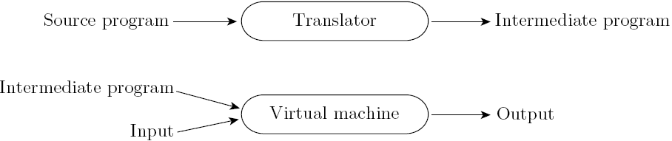
Compilation vs. Interpretation
Most language implementations mix compilation and interpretation
Common case compilation or pre-processing – followed by interpretation

Slide 8
Compilation vs. Interpretation
Compilation not required to produce machine code for hardware
Compilation translates one language into another, fully analyzing input’s meaning
Compilation requires semantic understanding of input
Preprocessing does not require semantic understanding, allows some errors through
Compiler hides subsequent steps
Preprocessor does not hide subsequent steps

Slide 9
Compilation vs. Interpretation
Compiled languages have interpreted features
  input/output formats
Compiled languages may use “virtual instructions”
  set operations
  string operations
Compiled languages might only produce virtual instructions, e.g., Java byte code

Slide 10
Compilation vs. Interpretation
Implementation strategy: Preprocessor
  removes comments and white space
  groups characters into tokens (keywords, identifiers, numbers, symbols)
  expands abbreviations and textual macros
  identifies higher-level syntactic structures (loops, subroutines)
  preserves structure of source in intermediate form

Slide 11
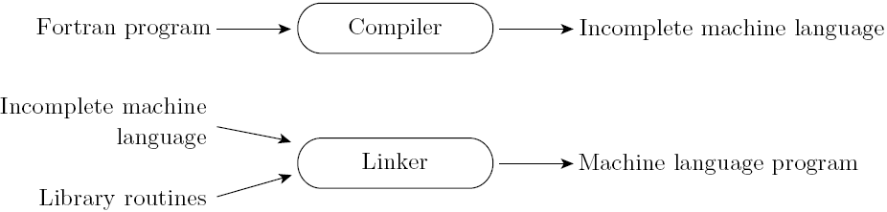
Compilation vs. Interpretation
Implementation strategy: Library and linking
  compiler uses linker program to merge appropriate subroutines from library

Slide 12
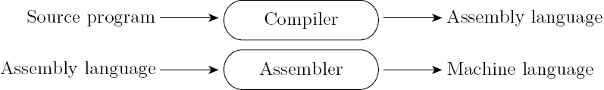
Compilation vs. Interpretation
Implementation strategy: Post-compilation assembly
  facilitates debugging (assembly easier to read)
  isolates compiler from changes in format of machine code files (e.g., between OS releases)

Slide 13
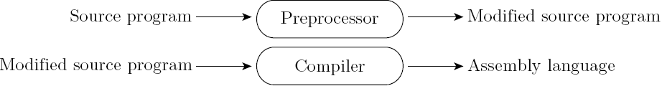
Compilation vs. Interpretation
Implementation strategy: Conditional compilation
  preprocessor deletes portions of code, several program versions share same source
  e.g., C’s preprocessor

Slide 14
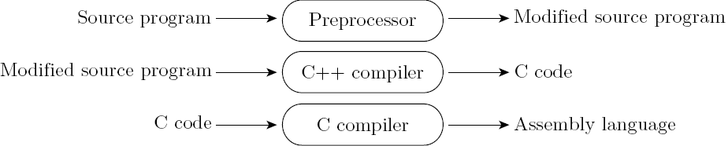
Compilation vs. Interpretation
Implementation strategy: Source-to-source translation
  generate intermediate program in another language (e.g., C++ to C, various to JavaScript)

Slide 15
Compilation vs. Interpretation
Implementation strategy: Compilation of interpreted languages
  Compiler generates code guessing about runtime circumstances
  If correct, code is fast
  If not, dynamic check reverts to normal interpreter

Slide 16
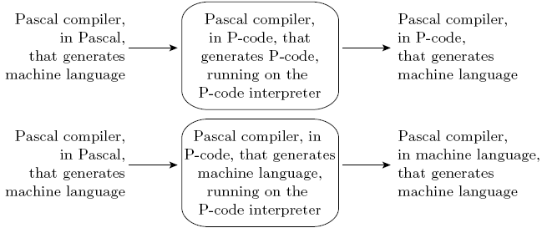
Compilation vs. Interpretation
Implementation strategy: Bootstrapping

Slide 17
Compilation vs. Interpretation
Implementation strategy: Dynamic and Just-in-Time compilation
  Deliberately delay compilation until last possible moment
    compile source code on the fly – dynamically created source -- optimize program for particular input
    use machine-independent intermediate code but compile to machine code when executed (e.g., Java just-in-time-compiler, .NET CIL)

Slide 18
Compilation vs. Interpretation
Implementation strategy: Microcode
    Assembly-level instruction set not implemented in hardware; runs on interpreter.
    Interpreter written in low-level instructions (microcode or firmware), stored in read-only memory, executed by hardware

Slide 19
Compilation vs. Interpretation
Compilers exist for some interpreted languages, but not pure
  selective compilation of part + sophisticated preprocessing of rest
  interpretation of part still necessary for reasons above
Unconventional compilers
  text formatters
  silicon compilers
  query language processors

Slide 20
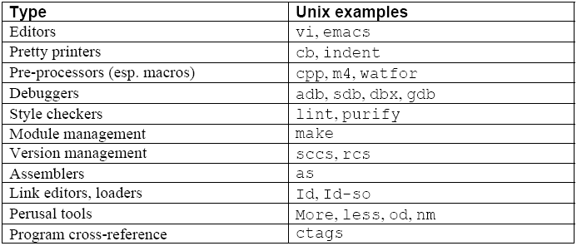
Programming Environment Tools
Tools

Slide 21
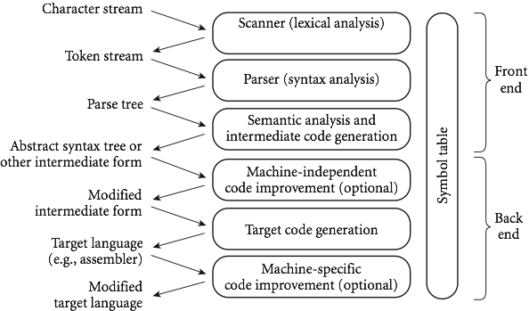
An Overview of Compilation
Phases of Compilation

Slide 22
An Overview of Compilation
Lexical Analysis (Scanning)
  recognize regular language using DFA
  take input character stream
  divide program into "tokens", smallest meaningful units to save time (char-by-char processing slow)
  recognize identifiers, constants, keywords, operators
  produce token stream
  do simple tasks early to reduce complexity later

Slide 23
An Overview of Compilation
Syntax Analysis (Parsing)
  recognize context-free language (CFG) using PDA
  take token stream (but could take character stream with no scanner, might be quite messy)
  discover context-free grammatical structure of program
  output error messages
  produce concrete syntax (parse) tree

Slide 24
An Overview of Compilation
Semantic analysis
  recognize context-sensitive aspects of syntax (often called static semantics, but misnamed in instructor’s opinion
  build symbol table
  take concrete syntax (parse) tree
  check type matches of variables and expressions
  produce abstract syntax tree or some other intermediate form

Slide 25
An Overview of Compilation
Intermediate form (IF)
  produced if no errors in syntax or static “semantics”
  machine code for idealized machine; e.g. stack machine or with unlimited number of registers
  chosen to balance machine independence, ease of optimization, ease of translation to final form, compactness
  might use several intermediate forms
  use abstract syntax trees and symbol table in our interpreters

Slide 26
An Overview of Compilation
Machine-independent optimization
  take intermediate-code program, optionally produce equivalent but “better” program – faster, smaller, etc.
  improve code, not really optimize
  produce another intermediate form program
  examples: common subexpression elimination, copy propagation, dead code elimination, loop optimizations, in-line function calls, tail recursion optimization

Slide 27
An Overview of Compilation
Code generation
  produce assembly language or relocatable machine language from intermediate form and symbol table
  assign memory locations, registers, etc.
Machine-specific optimization
  take output of code generation
  Optionally improve using specific details of machine, e.g., special instructions, addressing modes, co-processors

Slide 28
An Overview of Compilation
Symbol table
  track information about identifiers throughout all phases
  may be (partially) retained to support debugging, error recovery, reflection/metaprogramming

Slide 29
An Overview of Compilation
Lexical and Syntax Analysis: GCD program (in C)
int main() {
int i = getint(), j = getint();
while (i != j) {
  if (i > j) i = i - j;
  else j = j - i;
}
putint(i);
}

Slide 30
An Overview of Compilation
Lexical and Syntax Analysis: GCD program tokens
  Lexical analysis (scanning) and parsing recognize structure of program, group characters into tokens
        int main ( ) {
        int i = getint ( ) , j = getint ( ) ;
        while ( i != j ) {
        if ( i > j ) i = i - j ;
        else j = j - i ;
        }
        putint ( i ) ;
}

Slide 31
An Overview of Compilation
Lexical and Syntax Analysis: Context-Free Grammar and Parsing
    Parsing organizes tokens into a parse tree that represents higher-level constructs in terms of their constituents
    Potentially recursive rules known as context-free grammar define the ways in which these constituents combine

Slide 32
An Overview of Compilation
Context-Free Grammar and Parsing: Example (while loop in C)
iteration-statement → while ( expression ) statement
statement, in turn, is often a list enclosed in braces:
statement → compound-statement
compound-statement → { block-item-list opt }
where
block-item-list opt → block-item-list
or
block-item-list opt → ϵ
and
block-item-list → block-item
block-item-list → block-item-list block-item
block-item → declaration
block-item → statement

Slide 33
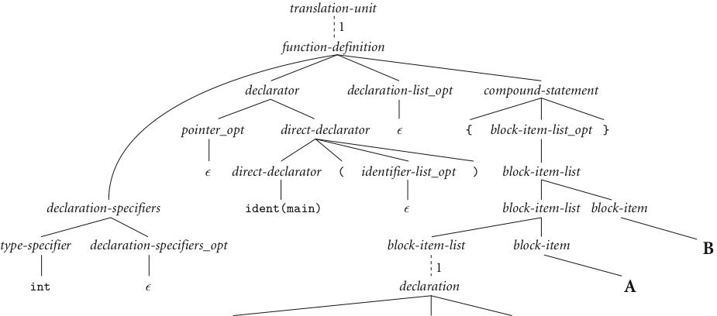
An Overview of Compilation
Context-Free Grammar and Parsing: GCD Program Parse Tree
B
A
next slide

Slide 34
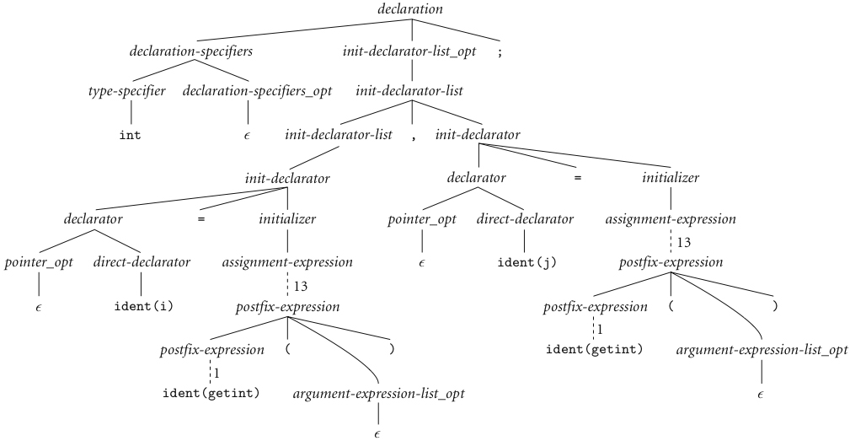
An Overview of Compilation
Context-Free Grammar and Parsing (continued)

Slide 35
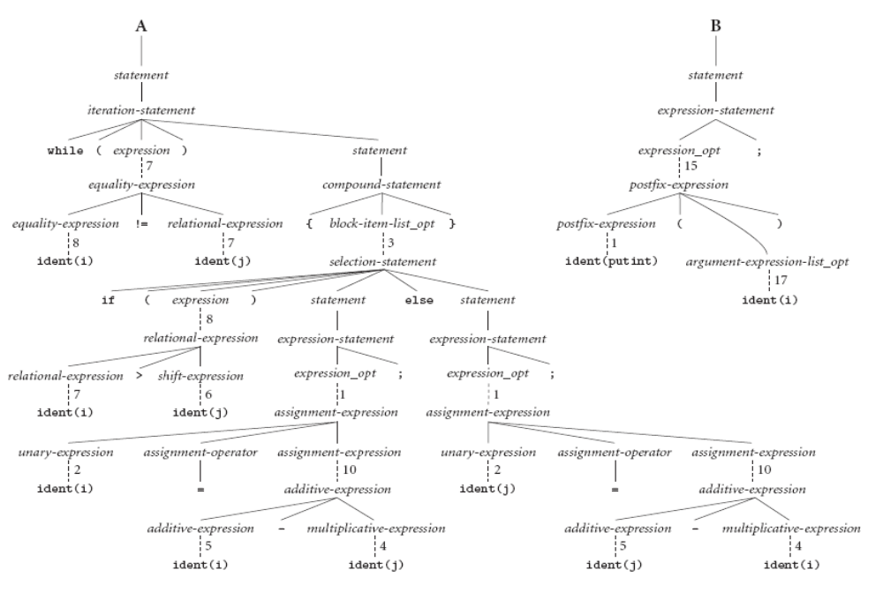
An Overview of Compilation
Context-Free Grammar and Parsing (continued)
A
B

Slide 36
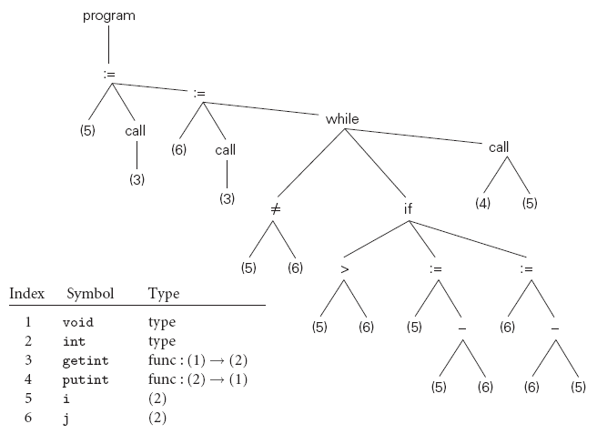
An Overview of Compilation
Syntax Tree: GCD Program Parse Tree

